Slide 1
Supporting SAIs in auditing the SDGs
A global view
Silke Steiner
INTOSAI General Secretariat

Slide 2
Results of SDG audits of SAIs: preparedness
SDG preparedness audits of SAIs
IDI-KSC Programme on Auditing SDGs
Compendium of audit findings in 2019 (in cooperation with UN DESA)

Slide 3
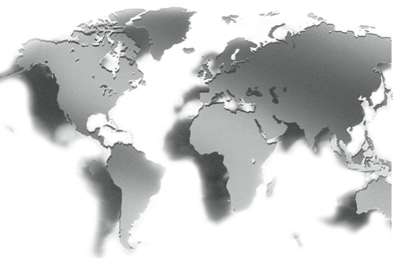
SDG audits of SAIs: implementation
Move from preparedness to implementation
Audit of concrete SDGs and targets
Tools like the “IDI SDGs Audit Model”

Slide 4
INTOSAI activities
Activities of INTOSAI Working Groups
and Subcommittees
WG on SDGs and Key Sustainable Development Indicators
WG on Environmental Auditing
SDG-related INTOSAI events

Slide 5
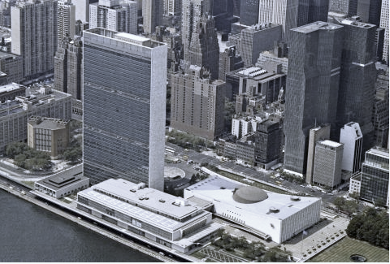
Cooperation with the United Nations
Two UN/INTOSAI Symposia
Three INTOSAI Side Events
at the UN HLFP
Three IDI-UNDESA “Leadership and Stakeholder Meetings”
Participation of INTOSAI representatives in the UN HPLF 2019

Slide 6
Next steps
XXIII INCOSAI – Moscow Declaration: SAIs will continue their SDG-related commitment
Coordinating function of the INTOSAI General Secretariat

Slide 7
Thank you very much for your attention

